Slide 1


SQL PIZZA SALES ANALYSIS

Slide 2

DATASOURCE
The datasource is obtained from Kaggle. The data is divided into 4 tables:
Order Details
Orders
Pizzas
Pizza types

Slide 3

Basic Questions
Retrieve the total number of orders placed.
select count(order_id) as total_orders from orders;

Slide 4

Calculate the total revenue generated from pizza sales.
select round(sum(order_details.quantity*pizzas.price),2) as total_sales
from order_details join pizzas
on pizzas.pizza_id = order_details.pizza_id;

Slide 5

Identify the highest-priced pizza.
select pizza_types.name,pizzas.price
from pizza_types join
pizzas on pizza_types.pizza_type_id=pizzas.pizza_type_id order by
pizzas.price desc limit 1;

Slide 6


Identify the most common pizza size ordered.
select pizzas.size, count(order_details.order_details_id) as order_count from pizzas
join order_details on
pizzas.pizza_id = order_details.pizza_id
group by pizzas.size order by order_count desc;

Slide 7


List the top 5 most ordered pizza types along with their quantities.
select pizza_types.name , sum(order_details.quantity) as quantity_ordered
from pizza_types join pizzas on
pizza_types.pizza_type_id = pizzas.pizza_type_id
join order_details on
order_details.pizza_id= pizzas.pizza_id group by pizza_types.name
order by quantity_ordered desc limit 5;

Slide 8


Intermediate Questions
Join the necessary tables to find the total quantity of each pizza category ordered.
select pizza_types.category, sum(order_details.quantity) as quantity
from pizza_types join pizzas
on pizza_types.pizza_type_id= pizzas.pizza_type_id
join order_details
on order_details.pizza_id = pizzas.pizza_id
group by pizza_types.category order by quantity desc;

Slide 9


Determine the distribution of orders by hour of the day.
select hour(time) as hour, count(order_id) as order_count from orders
group by hour ;

Slide 10


Join relevant tables to find the category-wise distribution of pizzas.
select category, count(name) as pizza_name from pizza_types
group by category;

Slide 11

Group the orders by date and calculate the average number of pizzas ordered per day.
select round(avg(quantity),0) as average_quantity from
(select orders.date, sum(order_details.quantity) as quantity from
orders join order_details
on orders.order_id= order_details.order_id
group by orders.date) as order_quantity ;

Slide 12

Determine the top 3 most ordered pizza types based on revenue.
select pizza_types.name, sum(pizzas.price * order_details.quantity) as total_revenue
from pizza_types join pizzas
on pizza_types.pizza_type_id= pizzas.pizza_type_id
join order_details on
pizzas.pizza_id = order_details.pizza_id
group by pizza_types.name order by total_revenue desc limit 3;

Slide 13


Advanced Questions
Calculate the percentage contribution of each pizza type to total revenue.
select pizza_types.category,
round(sum(order_details.quantity* pizzas.price)/(select round(sum(
order_details.quantity * pizzas.price),2) as total_sales from
order_details join pizzas on pizzas.pizza_id = order_details.pizza_id )*100,2)
as revenue
from pizza_types join pizzas on
pizza_types.pizza_type_id = pizzas.pizza_type_id
join order_details on
pizzas.pizza_id = order_details.pizza_id
group by pizza_types.category order by revenue desc;

Slide 14
Analyze the cumulative revenue generated over time.
select date,
sum(revenue) over (order by date) as cum_revenue from
(select orders.date, sum(order_details.quantity* pizzas.price) as revenue
from order_details join pizzas
on order_details.pizza_id= pizzas.pizza_id
join orders on orders.order_id= order_details.order_id
group by orders.date) as sales;

Slide 15


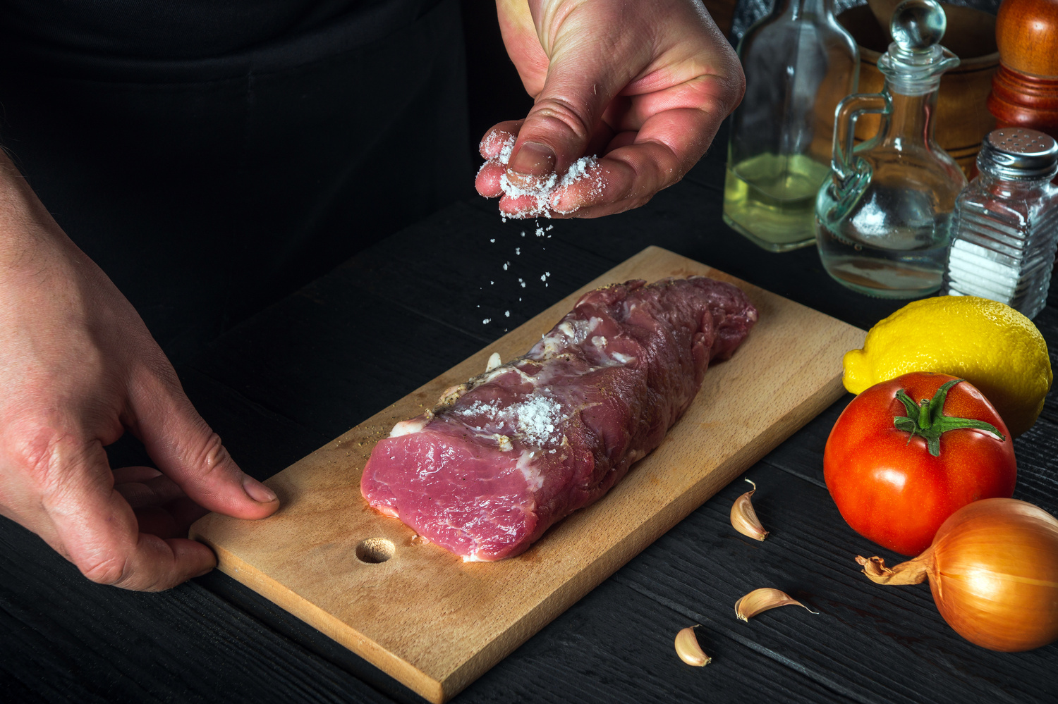

Determine the top 3 most ordered pizza types based on revenue for each pizza category.
select name, revenue from
(select category, name, revenue,
rank() over (partition by category order by revenue desc) as rn
from
(select pizza_types.category,pizza_types.name,
sum((order_details.quantity)* pizzas.price ) as revenue
from pizza_types join pizzas
on pizza_types.pizza_type_id = pizzas.pizza_type_id
join order_details
on order_details.pizza_id=pizzas.pizza_id
group by pizza_types.category,pizza_types.name) as a) as b
where rn<=3;

Slide 16




THANK YOU

